Slide 1
Pattern Recognition in Movie Data
This project recognizes patterns among the variables that affect the performance of movie at the box-office.
Notes:
A brief introduction and our brainstorming sessions.
Initial ideas of making models for ad’s and market analysis.
Our constraints for that idea.

Slide 2



Introduction
Idea:
As a part of the project we are trying to analyze patterns and build predictive models that can estimate the performance of a movie based on sentiment analysis and its popularity in social media for 2016 Hollywood movies from IMDB data.
Notes:
The final idea and what we wanted to do.

Slide 3


Data collection
IMDB Data.
Facebook Popularity (Sentiment Analysis from Comments.)
YouTube Popularity.
Notes:
Issues we faced with twitter data.
Collection and cleaning of data.
What all and how we collected the data.
Schyuzet package, fb api code, youtube and imbd data.
Fat data and data cleaning.

Slide 4
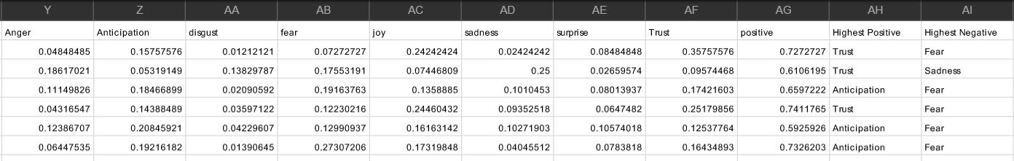
Sentiment analysis
Syuzhet Sentiment Analysis Package : https://cran.r-project.org/web/packages/syuzhet/index.html
R and Facebook API.
Generated Attributes
Dimensional Reduction

Slide 5
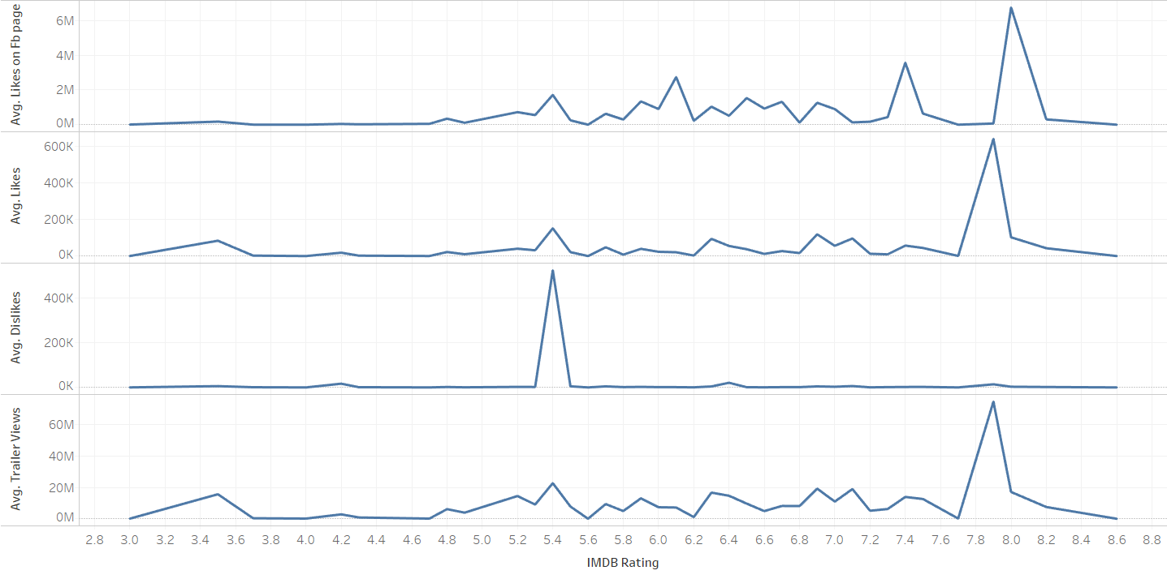
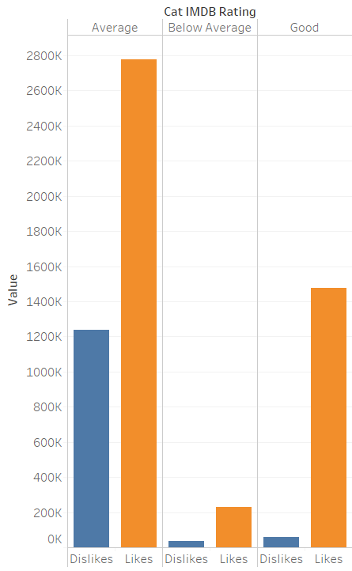
Pattern detection
Tableau IBM Watson Weka
Notes:
Explain weka pattern detection k-mean clustering
Ibm Watson data visualization

Slide 6
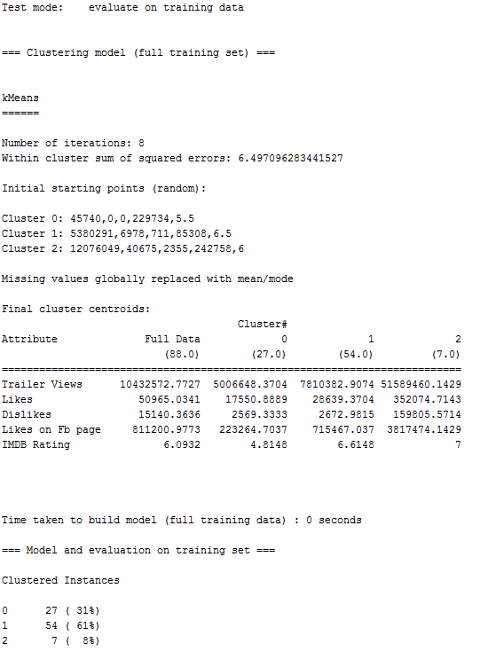
k-Means clustering

Slide 7
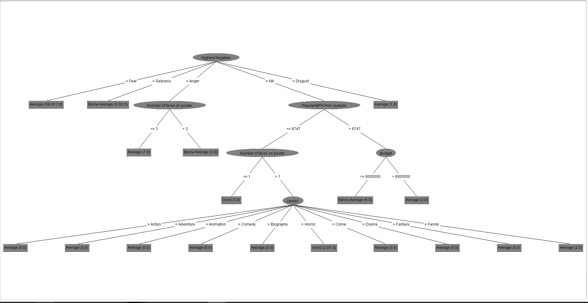
Decision Tree

Slide 8
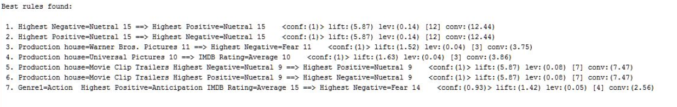
APRIORI Algorithm

Slide 9
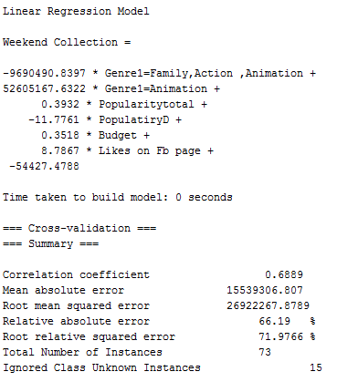
Linear Regression

Slide 10
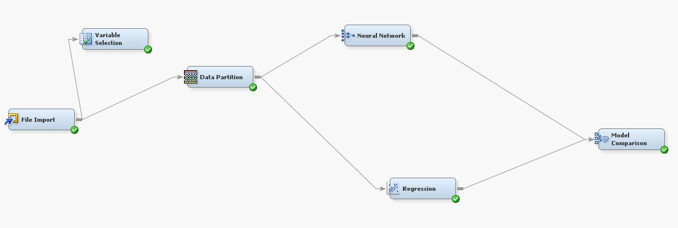
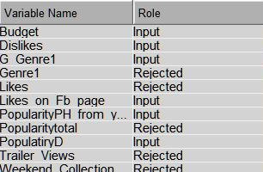
Neural Network

Slide 11
Conclusion
Which Model?
How to improve??

Slide 12
SUGGESTIONS?? QUESTIONS??

